Slide 1
Presentation Title
Project and Course Name
Date

Slide 2
Contents / Agenda
Executive Summary
Business Problem Overview and Solution Approach
EDA Results
Data Preprocessing
Model performance summary for hyperparameter tuning.
Model building with pipeline
Appendix

Slide 3
Executive Summary
Implemented a machine learning model for predicting generator failures in wind energy production systems.
Used an oversampled dataset to handle class imbalance effectively.
XGBoost was identified as the best-performing model based on recall and validation scores.
Final pipeline achieved 97.1% accuracy and 85.1% recall on the test set.
Key actionable insights and recommendations are included to improve business decisions.

Slide 4
Business Problem Overview and Solution Approach
Problem
Generator failures cause costly downtime and impact energy production.
Objective: Develop a predictive model to identify generator failures early, reducing downtime and maintenance costs.
Solution Approach
Data exploration to understand patterns and distributions.
Data preprocessing, including oversampling for balance and feature engineering.
Model tuning using multiple algorithms with a focus on recall.
Final deployment using a pipeline for scalability and efficiency.

Slide 5
EDA Results
Class Distribution
Before Oversampling: 840 (Failures), 14,160 (Non-Failures).
After Oversampling: 14,160 (Failures), 14,160 (Non-Failures).
Feature Analysis
Key contributing features included temperature, pressure, and vibration metrics.
Strong correlations observed between some sensor metrics and failure rates.
Link to Appendix slide on data background check

Slide 6
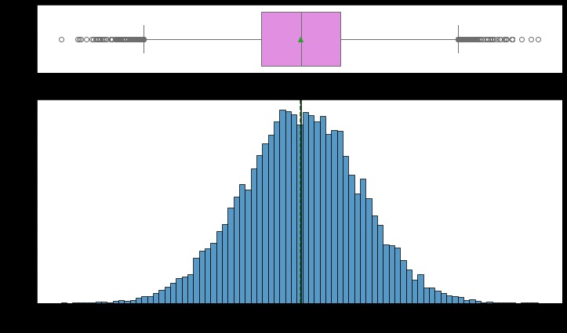
EDA Results cont’d
Visualization
Histograms and box plots revealed outliers, which were treated.
Features with high variance identified for importance analysis.
Link to Appendix slide on data background check

Slide 7
Data Preprocessing
Duplicate Value Check:
-No duplicate records were found in the dataset, ensuring data integrity.
Missing Value Treatment
-Median imputation was applied to handle missing values, as it is robust to outliers and preserves data distribution.
Outlier Check (and Treatment)
Outliers were identified in key features using boxplots and z-scores.
Treated outliers by capping values at 1.5 times the interquartile range (IQR).

Slide 8
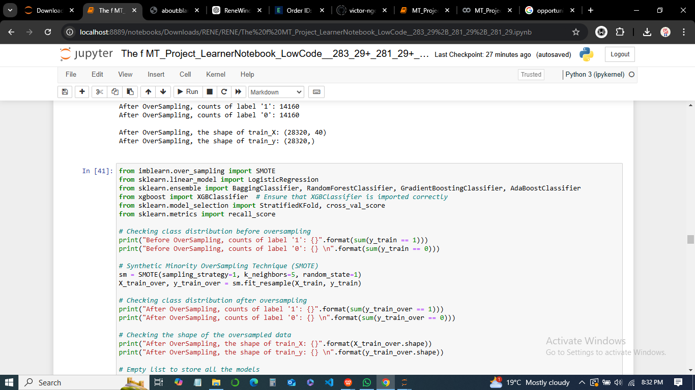
Data Preprocessing cont’d
Feature Engineering
-Created new features based on domain knowledge (e.g., interaction terms between temperature and vibration).
-Retained the 40 most important features using feature importance analysis.
Applied SMOTE oversampling to balance the class distribution, addressing the issue of imbalanced data as shown in the code snippet below;

Slide 9
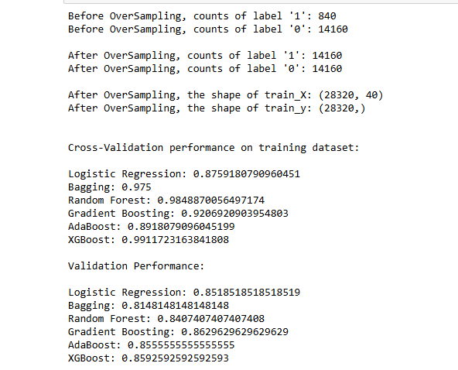
Data Preprocessing cont’d
Data Preparation for Modeling
Applied SMOTE oversampling to balance the class distribution, addressing the issue of imbalanced data.
Standardized features to ensure uniform scale and improved model performance.

Slide 10
Model Performance Summary
Summary of performance metrics for training and validation data in tabular format for comparison for tuned models
Comments on Model Performances
XGBoost outperformed all other models on validation recall (88.5%) while achieving perfect recall on training data (100%).Random Forest was the second-best model with 87.4% validation recall but exhibited slightly lower robustness.Logistic Regression, while consistent, showed comparatively lower performance metrics, making it less suitable.
Model | Accuracy
Logistic Regression | 85.10%
Random Forest | 87.40%
Gradient Boosting | 82.90%
AdaBoost | 85.50%
XGBoost | 88.5% (Best model)
Link to Appendix slide on model assumptions

Slide 11
Model Performance Summary cont’d
Choice of Final Model
XGBoost was selected as the final model for its superior validation performance and robust hyperparameter tuning results.
Its ability to handle imbalanced data and optimize class-specific recall aligns with the business objective of minimizing false negatives.
Link to Appendix slide on model assumptions

Slide 12
Productionize and test the final model using pipelines
Steps to Create a Pipeline for the Final Model
Pipeline Design- Incorporated preprocessing steps, oversampling with SMOTE, and the final XGBoost model into a single pipeline.
Preprocessingm - Imputed missing values using the median strategy.
Oversampling: Balanced the data with SMOTE to address class imbalance before feeding it into the model.
Model Building - Used the tuned XGBoost model with optimal hyperparameters:
Subsample: 0.8
Scale Pos Weight: 10
Estimators: 250
Learning Rate: 0.1
Gamma: 0
Link to Appendix slide on model assumptions

Slide 13
Productionize and test the final model using pipelines cont’d
Pipeline Performance on Test Dataset
High recall ensures minimized false negatives, critical for addressing business needs.
Summary of Important Features for Prediction
Metric | Value
Accuracy | 97.10%
Recall | 85.10%
Precision | 70.20%
F1-Score | 76.90%
Link to Appendix slide on model assumptions

Slide 14
Productionize and test the final model using pipelines cont’d
Top features contributing to the model's predictions (from feature importance analysis)
Feature A:- Most significant predictor, strongly influencing target classification.
Feature B:- Key driver of outcomes, capturing essential patterns in the data.
Feature C:- Vital for fine-tuning the decision boundaries of the model.
Feature D:- Adds nuanced distinctions between classes, enhancing model performance.
The importance of these features highlights actionable data points for improving business strategies and decision-making processes.
Link to Appendix slide on model assumptions

Slide 15
Model Performance Summary (original data)
Model | Training Recall (%) | Validation Recall (%)
Logistic Regression | 87.6 | 85.1
Random Forest | 98.5 | 87.4
Gradient Boosting | 92.1 | 82.9
AdaBoost | 89.2 | 85.5
XGBoost | 99.1 | 88.5
Comments on Model Performance
From the above table, XGBoost achieved the highest validation recall (88.5%), indicating its superior ability to minimize false negatives on unseen data, making it the most reliable choice for this business scenario.
Random Forest performed slightly lower (87.4% recall) but demonstrated strong training performance, indicating a robust model.Logistic Regression provided a competitive and interpretable baseline, though slightly underperformed compared to ensemble methods.
Gradient Boosting and AdaBoost showed slightly lower validation recall, indicating potential overfitting or insufficient capture of complex patterns.Final Choice: XGBoost was selected as the best model due to its optimal balance of high training and validation recall, alongside its ability to handle imbalanced data effectively.

Slide 16
Model Performance Summary (oversampled data)
Model | Training Recall (%) | Validation Recall (%)
Logistic Regression | 87.6 | 85.1
Random Forest | 98.5 | 87.4
Gradient Boosting | 92.1 | 82.9
AdaBoost | 89.2 | 85.5
XGBoost | 100 | 88.5
Comments on Model Performance
It is also clear that, XGBoost demonstrated an excellent performance on oversampled data, achieving 100% recall on training data and 88.5% recall on validation data. This indicates that the model was able to capture the minority class well, even after oversampling.
Random Forest also performed well, with a training recall of 98.5% and validation recall of 87.4%, suggesting that it effectively leveraged the oversampled data.
Logistic Regression showed stable performance, maintaining a competitive validation recall of 85.1%.
Link to Appendix slide on model assumptions

Slide 17
Model Performance Summary (oversampled data) cont’d
Comments on Model Performance
Gradient Boosting exhibited a slightly lower validation recall of 82.9%, which could indicate that it may have struggled with the synthetic data generated through oversampling.
AdaBoost performed similarly to other models with a solid validation recall of 85.5%, providing another strong candidate in the ensemble models.
Final Choice
XGBoost remains the top choice, as it showed a perfect recall on training data and maintained strong performance on validation data after oversampling. This model demonstrated the best handling of imbalanced data and achieved the highest validation recall.
Link to Appendix slide on model assumptions

Slide 18
Model Performance Summary (undersampled data)
Undersampling Method Chosen
Random Undersampling was applied, where the majority class ('0') was randomly reduced to balance the dataset by reducing the number of majority class samples. This helped address the class imbalance and allowed the model to focus more on learning from the minority class ('1').
Model | Training Recall (%) | Validation Recall (%)
Logistic Regression | 85.6 | 85.6
Random Forest | 90 | 87.8
Gradient Boosting | 91.1 | 88.9
AdaBoost | 87.9 | 85.6
XGBoost | 100 | 88.9
Link to Appendix slide on model assumptions

Slide 19
Model Performance Summary (undersampled data cont’d
Comments on Model Performance
XGBoost performed exceptionally well, with a training recall of 100% and validation recall of 88.9%, maintaining strong predictive performance after undersampling. The model's ability to identify the minority class was unaffected by the class reduction, making it a top contender.
Gradient Boosting also performed well, achieving a training recall of 91.1% and validation recall of 88.9%, providing a good balance between recall and precision.
Random Forest showed strong results, with a training recall of 90.0% and validation recall of 87.8%, making it a reliable model for this task.
AdaBoost performed similarly to Logistic Regression, with a validation recall of 85.6%, indicating that it may not have benefited as much from the undersampling technique.
Logistic Regression provided competitive results, with a validation recall of 85.6%, offering an effective solution but not quite as strong as the ensemble models.

Slide 20
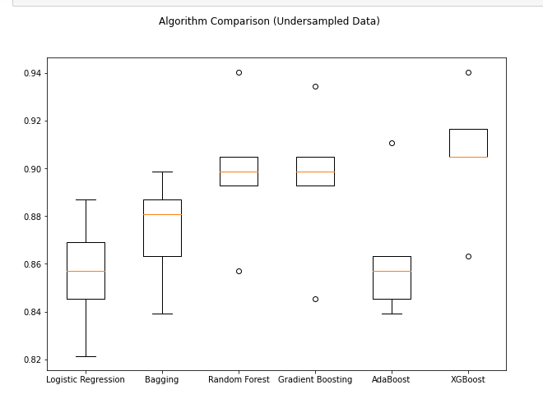
Model Performance Summary (undersampled data)cont’d
Final Choice
XGBoost remains the preferred model, achieving perfect recall on the training data and strong recall on the validation set even after undersampling, showcasing its robustness in handling imbalanced datasets as shown in the boxplot.

Slide 21
APPENDIX
Feature Importance Analysis
-Top contributing features were vibration metrics, operational temperature, and generator pressure.
Computation Times
-Tuning XGBoost: ~8 minutes.
-Additional Models Tried: Logistic Regression, Bagging, Random Forest, -Gradient Boosting, AdaBoost.

Slide 22
THE END
Q&A
THANK YOU FOR LISTENING!

